Slide 1
Auto Insurance Churn Analysis
Group 10

Slide 2
What’s “Churn”?

Slide 3
Why Predicting Churn Matters in Insurance?
Acquiring new customers is much more expensive than retaining the existing ones
High churn leads to lost revenue and higher marketing costs
Signals possible issues with customer satisfaction or product offerings

Slide 4
Business Problem
How can we accurately predict which customers are likely to churn?
What are the factors that lead to churn?

Slide 5
Impact of Understanding Churn Factors
Enables proactive, personalized retention strategies
Improves customer satisfaction
Optimizes pricing models to reduce the churn

Slide 6
Data Overview
~92,000 customers, 23 features
Data types: numerical, categorical, date
Key Feature Categories:
Demographics: DOB, age, education, marital status, children, home ownership
Financials: income, home market value, credit rating
Policy Details: annual premium, tenure, policy start date, acct suspended date
Geographic: city, county, latitude/longitude
Churn Indicator: 1 = churned, 0 = retained

Slide 7
Data Summaries & Data Quality Issues
Average tenure ~10 years (range: 20 days to 17 years) | Mean annual premium: $940 (wide range, min: -$84)
Average income ~$81,500 | 82% homeowners
Average age ~56 years (max: 113 years) | 35% have college degrees
84% have good credit rating | 52% have children
Missing values in ‘City’, ‘County’, ‘home_market_value’

Slide 8
Handling Missing Values
VARIABLE | METHOD APPLIED
Longitude and Latitude (15%) | Fillna(city_avg_coord)
City and County (0.7%) | Fillna(“Unknown”)
Home_market_value (5%) | Dropna()
Acct_suspd_date (88%) | Drop the column
Address_id and Individual_ID | Drop the columns

Slide 9
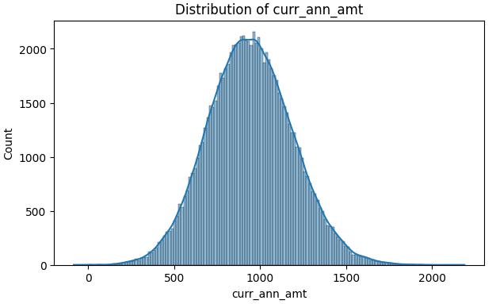
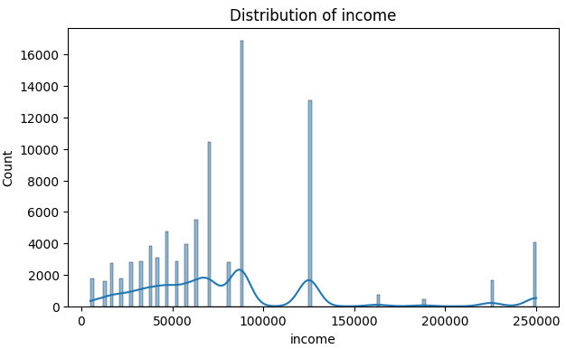
Quantitative Variables Exploration

Slide 10
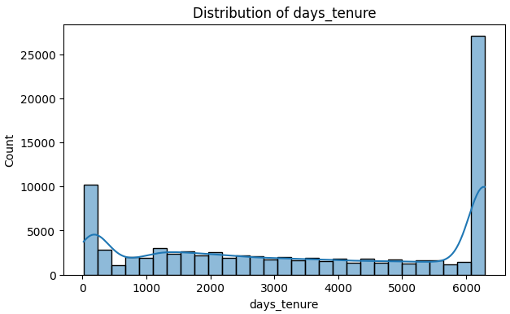
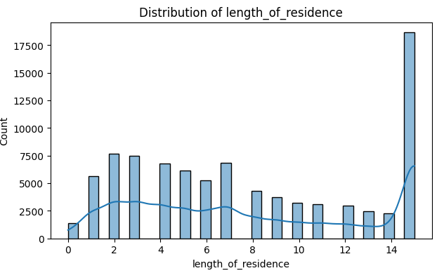
Quantitative Variables Exploration

Slide 11
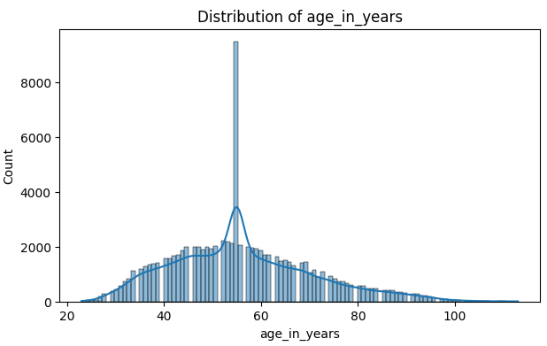
Quantitative Variables Exploration

Slide 12
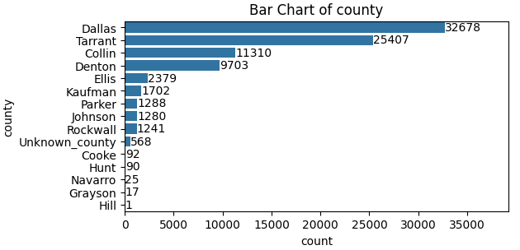
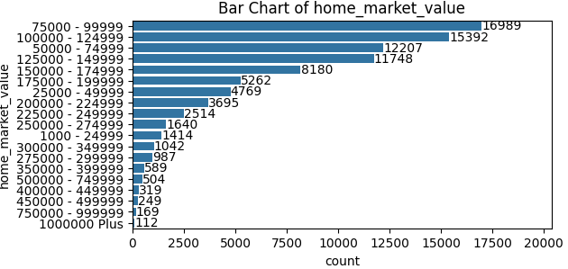
Categorical Variables Exploration

Slide 13
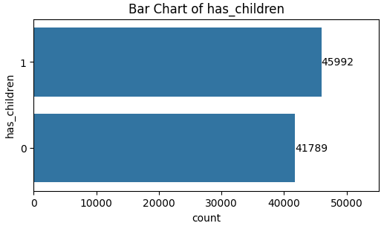
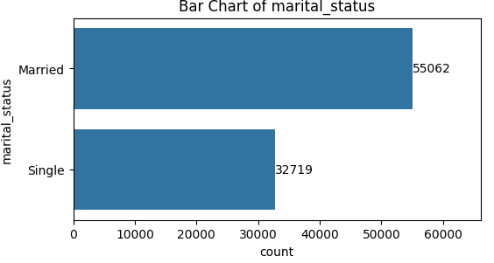
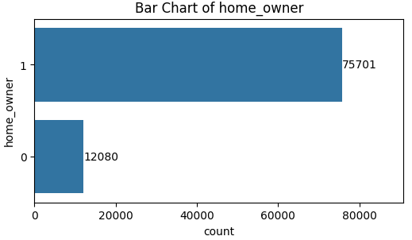
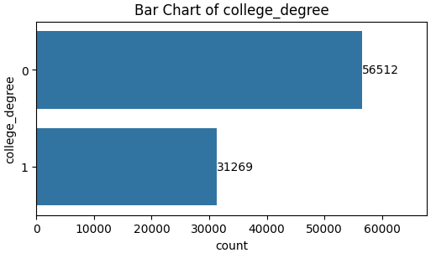
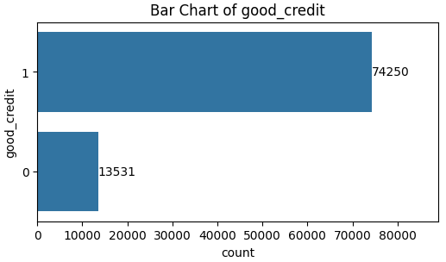
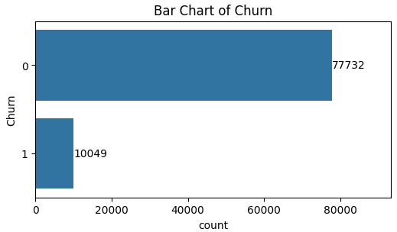
Categorical Variables Exploration
has_children
marital_status
home_owner
college_degree
good_credit
churn

Slide 14
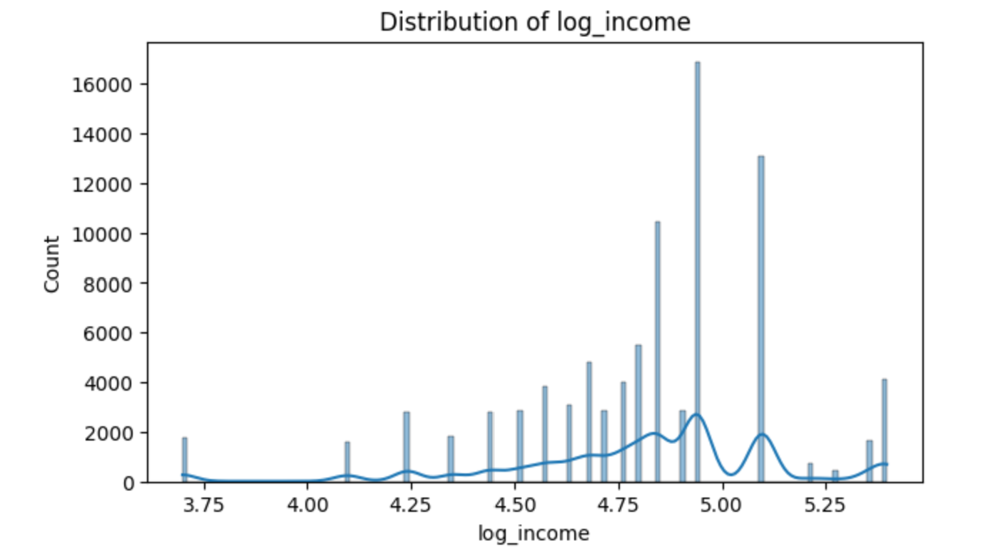
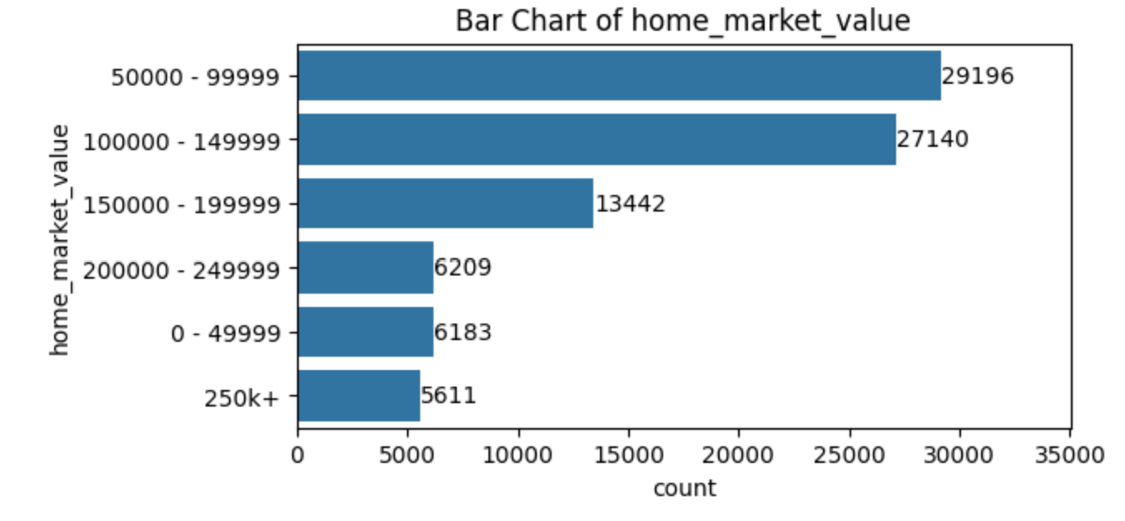
Feature Engineering
Distribution of log_income
home_market_value
Applied log transformation to the income variable to reduce skewness and standardized the variable.
Grouped(Binning) home values into ranges to improve reduce the impact of noise or outliers.

Slide 15
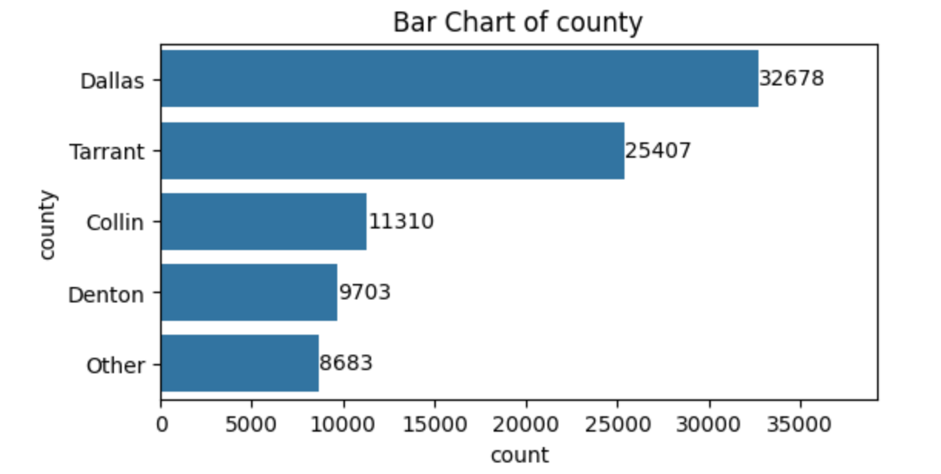
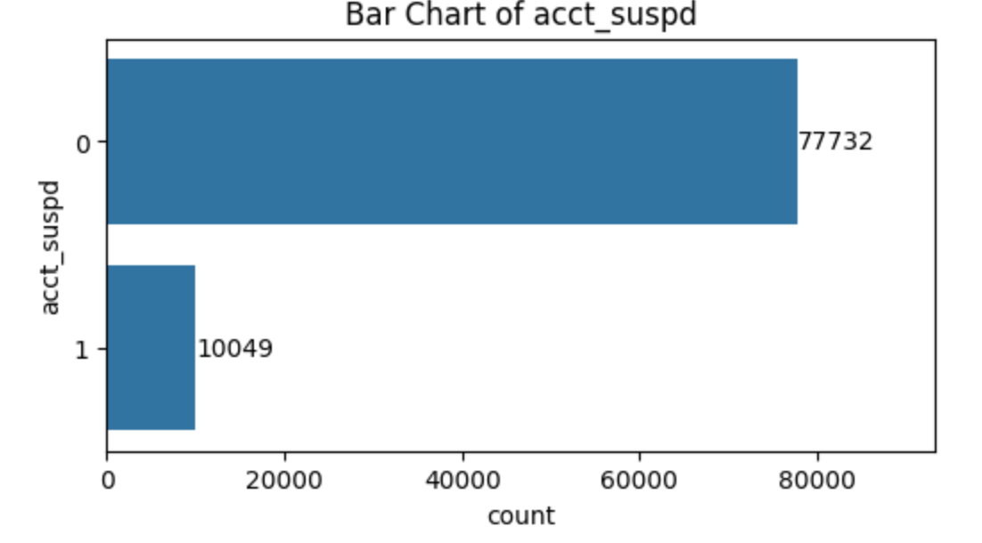
Feature Engineering
county
acct_suspd
Retained top 4 counties; grouped others into a single "Other" category to simplify and better analysis
Created acct_suspd column (1 = Yes, 0 = No) to enhance the readability.

Slide 16
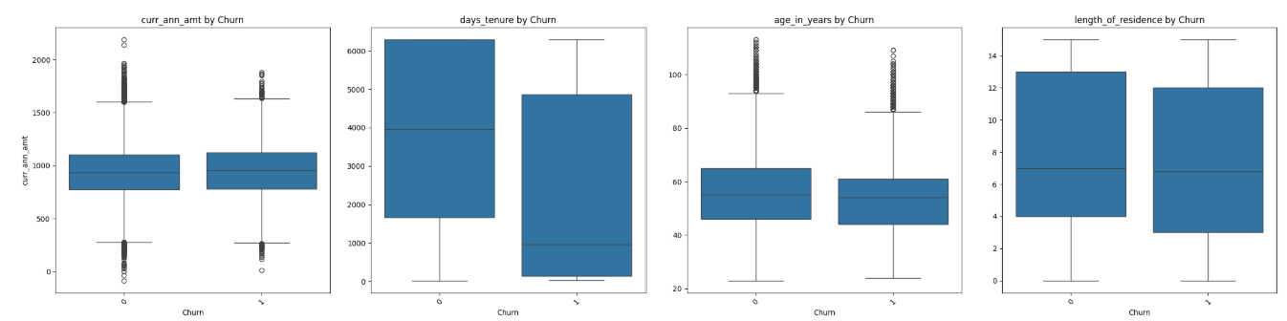
Analyzing Predictors Using Boxplots
curr_ann_amt
days_tenure
age_in_years
length_of_residence
churn
churn
churn
churn
Variables like income, length of residence, age in years, and current annual amount show minimal impact on churn.
Tenure (cust_orig_months and days_tenure) is a strong predictor of churn.

Slide 17
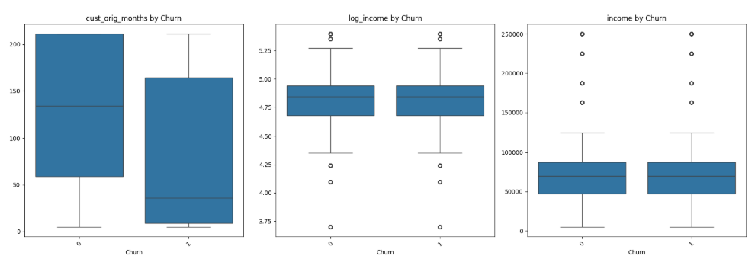
Analyzing Predictors Using Boxplots
cust_orig_months
log_income
income
churn
churn
churn

Slide 18
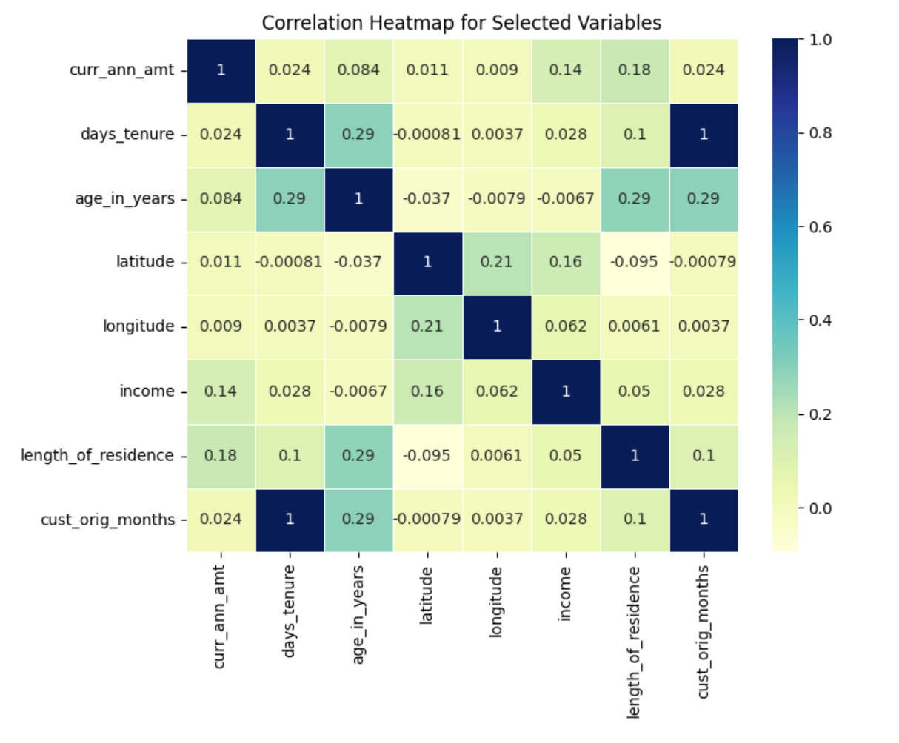
Correlation Matrix
Multicollinearity: Strong correlation exists between cust_orig_months and days_tenure.
Action: Dropped cust_orig_months to reduce redundancy and multicollinearity risks.

Slide 19
Data Pre-processing
Feature Selection
Dropped redundant, non-informative, or highly correlated columns
Data Transformation
Created dummy variables for home_market_value, marital_status, and county to convert categorical data into numerical format for model compatibility.

Slide 20
Data Pre-processing
Standard Scaler
Used StandardScaler() to standardize features by removing the mean and scaling to unit variance.
Training and Testing data split
80:20 split, 80% of our data is Training Data and 20% of our data is Testing, test size was set to 0.2

Slide 21
Classification Models Applied
Decision Tree
SMOTE
Feature Importance
Logistic Regression
Optimal Threshold
K-Nearest Neighbors (KNN)
Hyperparameter Tuning
Voting Classifier

Slide 22
Decision Tree
Initially tested with various parameters:
Depth: 6, 7, 8
Minimum Leaf Samples: 500, 1000, 3000
Best results:
Depth = 8, Minimum Leaf Samples = 3000
However, the tree suffers from class imbalance (1 = minority). So we applied SMOTE to address the issue.

Slide 23
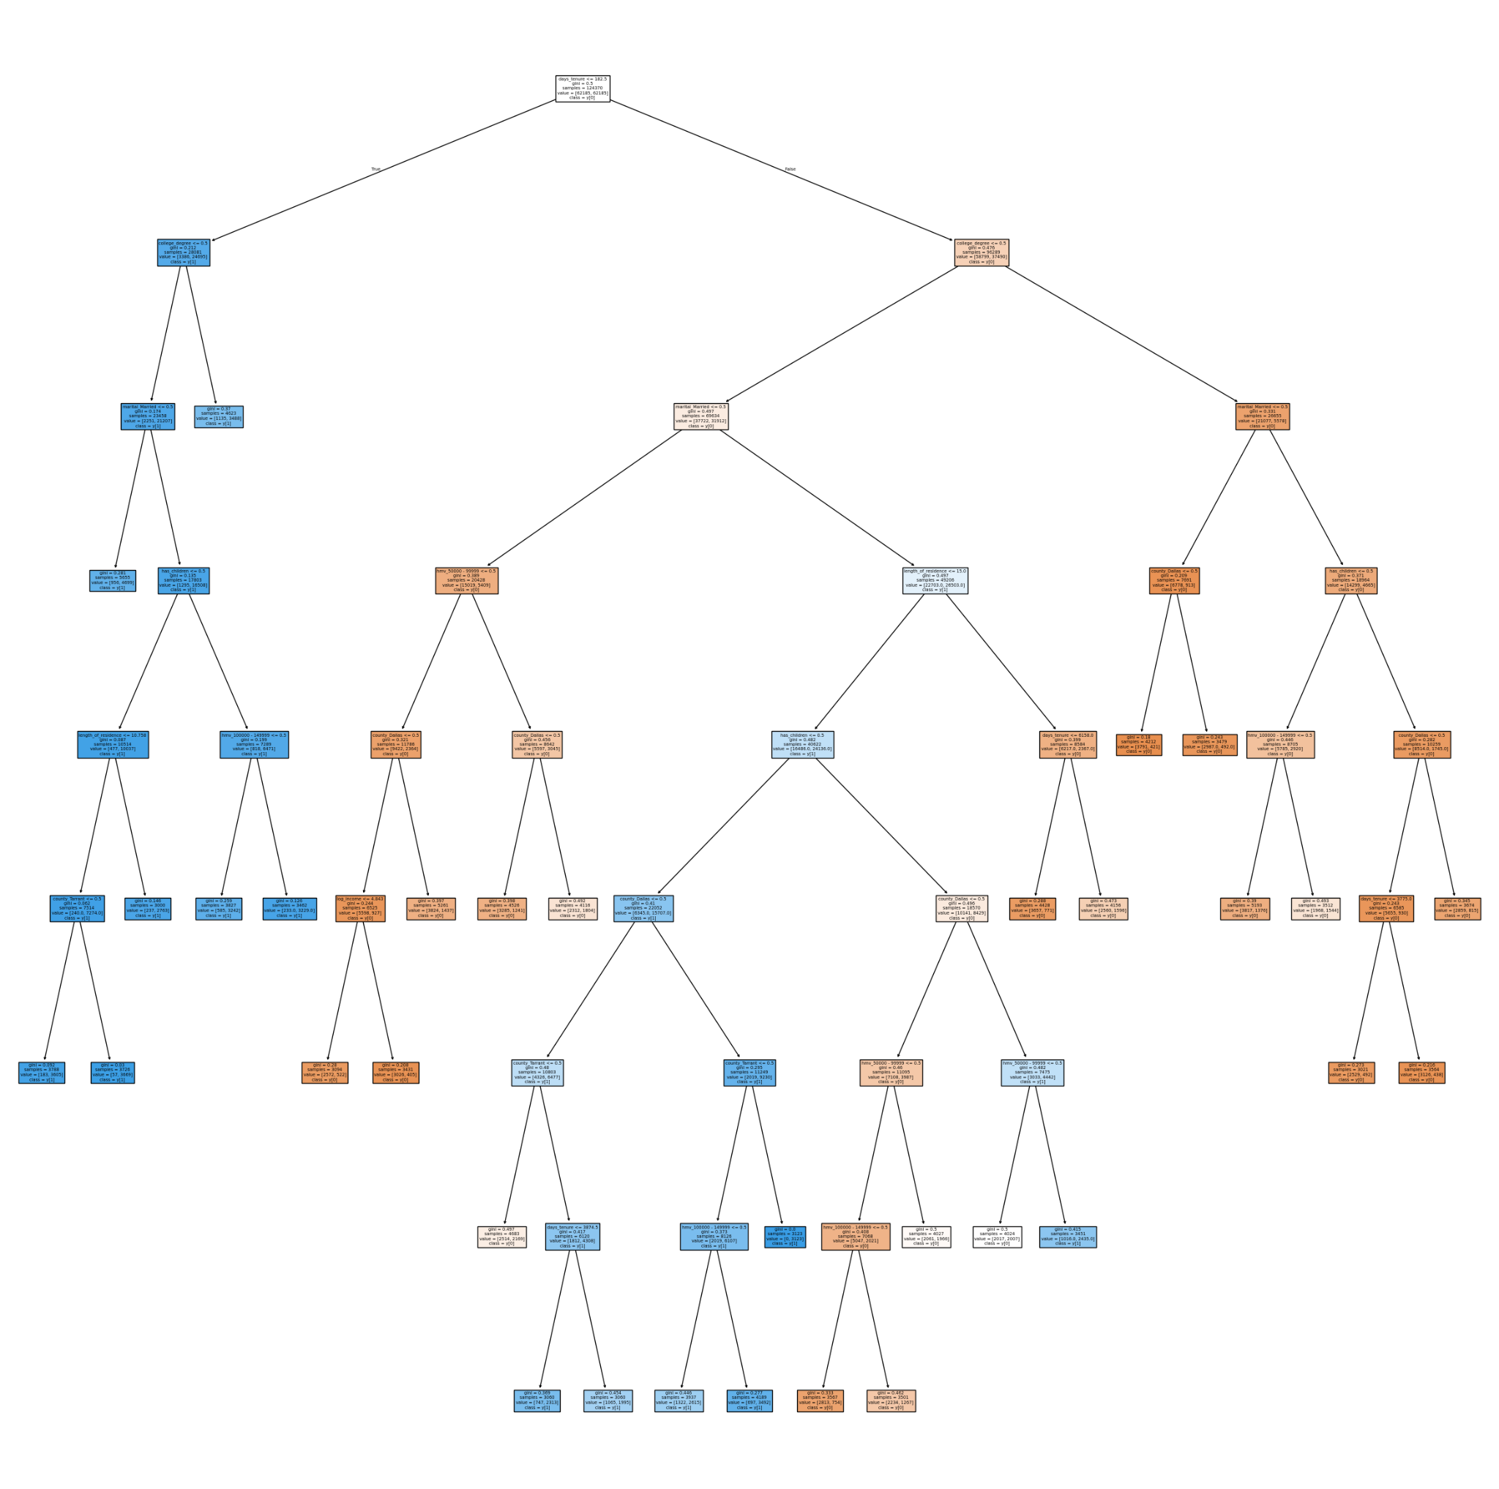
Tree Diagram (after SMOTE)
Days_tenure <= 182.5
College_degree <= 0.5

Slide 24
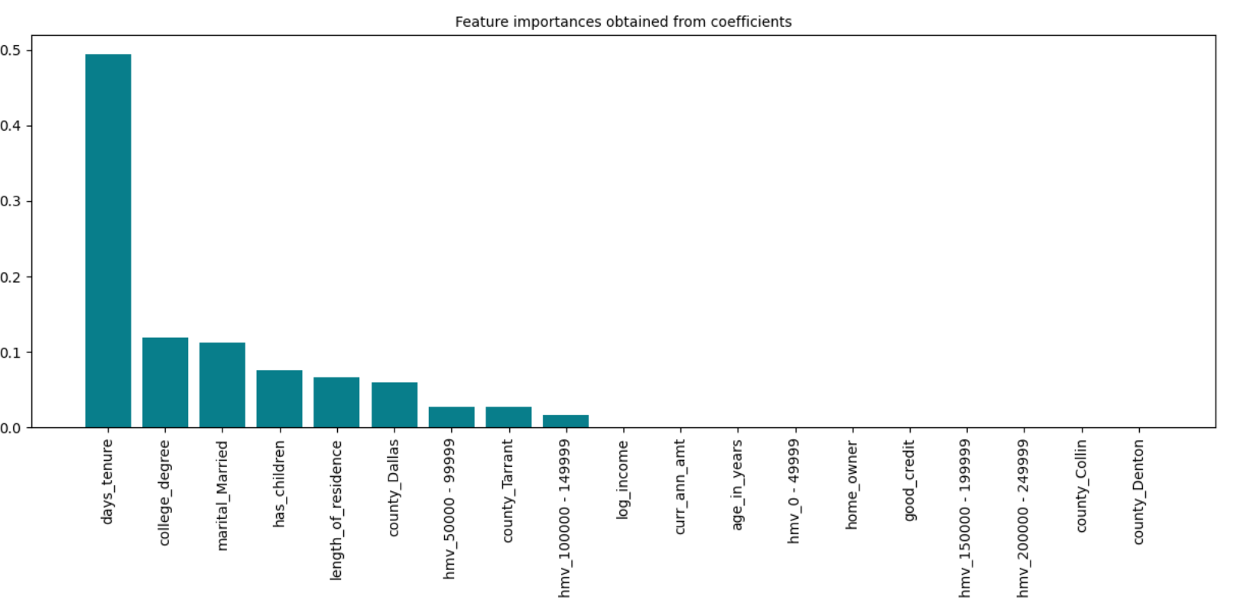
Feature Importances

Slide 25
Logistic Regression
Steps:
Class_weight parameter = “balanced” -> Addresses the class imbalance issue.
5-fold cross validation applied to assess model stability and performance variability.
Achieved precision and recall of 0.16 and 0.66 respectively -> Large difference between the metrics.
Next, we find an optimal threshold to balance precision and recall.

Slide 26
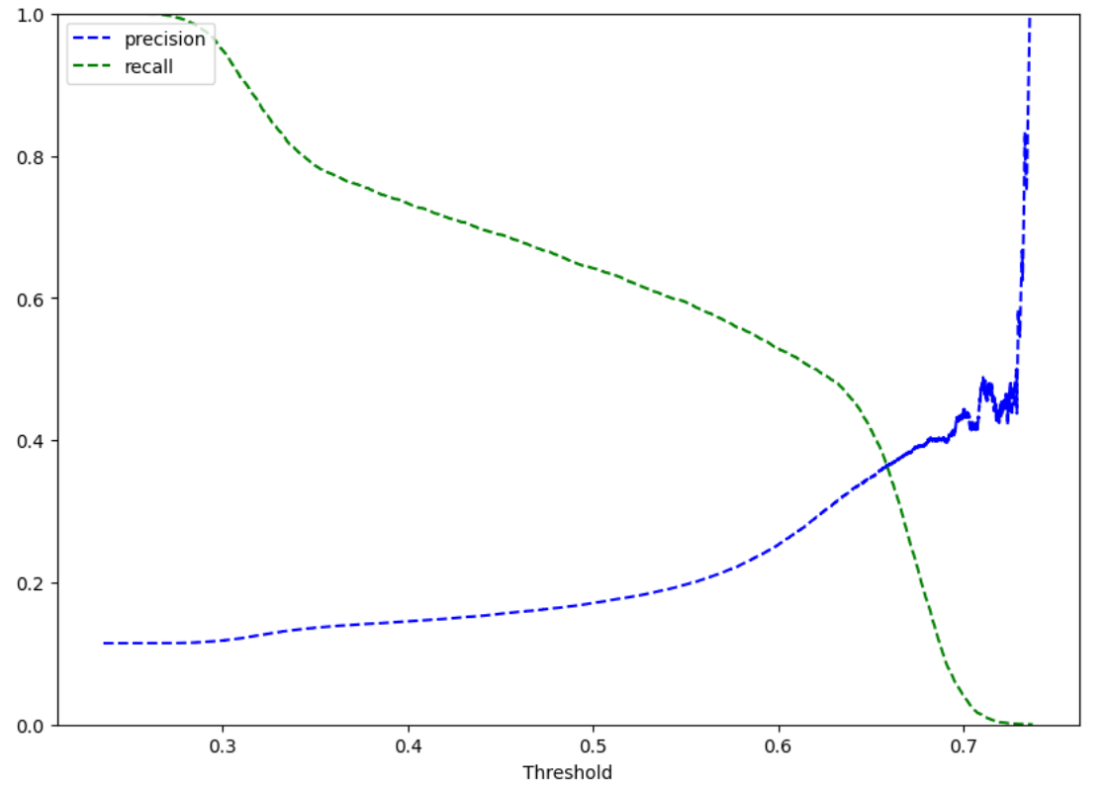
Precision vs Recall Curve for Optimal Threshold
Threshold = 0.66

Slide 27
K-Nearest Neighbors (KNN)
Steps:
Loop over a few values of k to determine the best value.
Plot the error rate vs number of neighbors (k) graph for training and validation dataset.
We chose k=5 to best balance - error rate, overfitting and underfitting issues.
Next, we performed hypertuning to further improve the model’s performance.

Slide 28
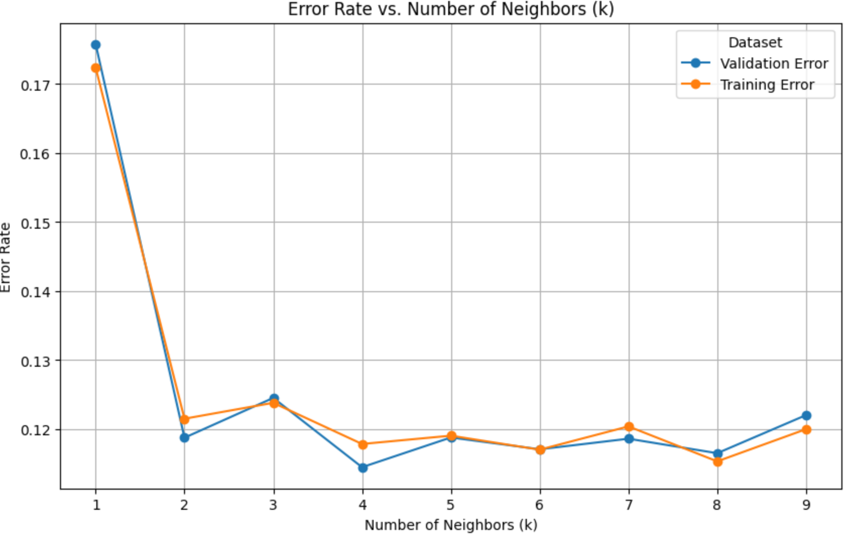

Slide 29
Voting Classifier
Decision Tree
K-Nearest Neighbor
Logistic Regression
Voting Classifier
Output

Slide 30
Comparing Model Performances (Class-1):
Model | Accuracy | Precision | Recall | F1 Score
Decision Tree | 0.89 | 0.52 | 0.21 | 0.30
Decision Tree (With SMOTE) | 0.82 | 0.32 | 0.47 | 0.38
Logistic Regression | 0.60 | 0.17 | 0.66 | 0.28
Logistic Regression (Optimal) | 0.86 | 0.37 | 0.36 | 0.37
K-Nearest Neighbors | 0.88 | 0.44 | 0.19 | 0.26
Voting Classifier | 0.89 | 0.50 | 0.33 | 0.39

Slide 31
Comparing Model Performances (Class-1):
Model | Accuracy | Precision | Recall | F1 Score
Decision Tree | 0.89 | 0.52 | 0.21 | 0.30
Decision Tree (With SMOTE) | 0.82 | 0.32 | 0.47 | 0.38
Logistic Regression | 0.60 | 0.17 | 0.66 | 0.28
Logistic Regression (Optimal) | 0.86 | 0.37 | 0.36 | 0.37
K-Nearest Neighbors | 0.88 | 0.44 | 0.19 | 0.26
Voting Classifier | 0.89 | 0.50 | 0.33 | 0.39

Slide 32
Comparing Model Performances (Class-1):
Model | Accuracy | Precision | Recall | F1 Score
Decision Tree | 0.89 | 0.52 | 0.21 | 0.30
Decision Tree (With SMOTE) | 0.82 | 0.32 | 0.47 | 0.38
Logistic Regression | 0.60 | 0.17 | 0.66 | 0.28
Logistic Regression (Optimal) | 0.86 | 0.37 | 0.36 | 0.37
K-Nearest Neighbors | 0.88 | 0.44 | 0.19 | 0.26
Voting Classifier | 0.89 | 0.50 | 0.33 | 0.39

Slide 33
Conclusion:
Best model observed - Decision Tree with SMOTE
Provides strong performance with a balance of precision and recall.
Economically better and suitable for large datasets

Slide 34
Business Recommendations:
Factors Affecting Churn | Impact on Churn | Strategy
Medium-to-high home values ($50,000–$150,000) and customers with children | Increases | Design personalized offers, family-centric loyalty programs, and retention campaigns
Longer tenure customers (over 5 years) | Decreases | Offer anniversary rewards, loyalty benefits, and exclusive retention incentives
Shorter tenure customers (under 1 year) | Increases | Provide introductory offers, proactive onboarding, and regular check-ins to build early loyalty
High proportion with good credit (84%) and college degrees (35%) | Decreases | Use tailored messaging and value-based offerings for creditworthy, educated individuals

Slide 35
Business Recommendations:
Factors Affecting Churn | Impact on Churn | Strategy
Customers in lower-to-middle income range | Increases | Offer low-cost or value-based insurance products to appeal to price-sensitive segments
Recently relocated customers | Increases | Identify recent movers and engage them with personalized incentives and stay-benefits
Younger individuals and customers with shorter tenure | Increases | Implement onboarding programs, age-relevant engagement, and early financial incentives
High percentage of homeowners | Decreases | Promote home-related benefits, such as home insurance discounts or bundling offers

Slide 36
Questions and Answers

Slide 37
Thank you

